Slide 1
Traffic Congestion Reporting and Management System
Barkha Samyani 001417278
Hruda Mohod 001426345
Varsha Premani 001442071

Slide 2
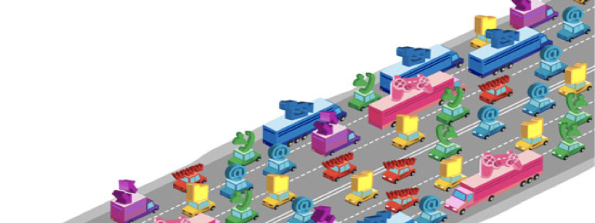
Todays major problem: Traffic Congestion

Slide 3
Problem Statement:
The commute time gets delayed due to the various factors that causes traffic.
This project facilitates manual and automatic reporting of congestion on the various routes. It also enables Traffic Congestion Management and Construction Department to view and give resolution to the problems reported for the same.

Slide 4
Proposed Solution:
By controlling the reasons causing traffic congestion we can avoid traffic congestion. Some of the solutions are
Having a common portal for Commuters, Traffic Managers and Construction Department.
Installing sensors at various places and reporting congestion to Traffic Congestion Management or Construction department.
Suggesting commuters way they should choose to go with.
Allowing the government to predict the traffic pattern based on various analysis done.

Slide 5
Approach
In order to allow manual and automatic reporting of Congestion , our system allows to report congestion via manual inputs or automatic sensors.
This report will be send to the Construction Department and Traffic Congestion management according to the type of the request.
The Construction Department and Traffic Congestion management will send the proposed solution and the other commuter can check if the route has been cleared or not.

Slide 6
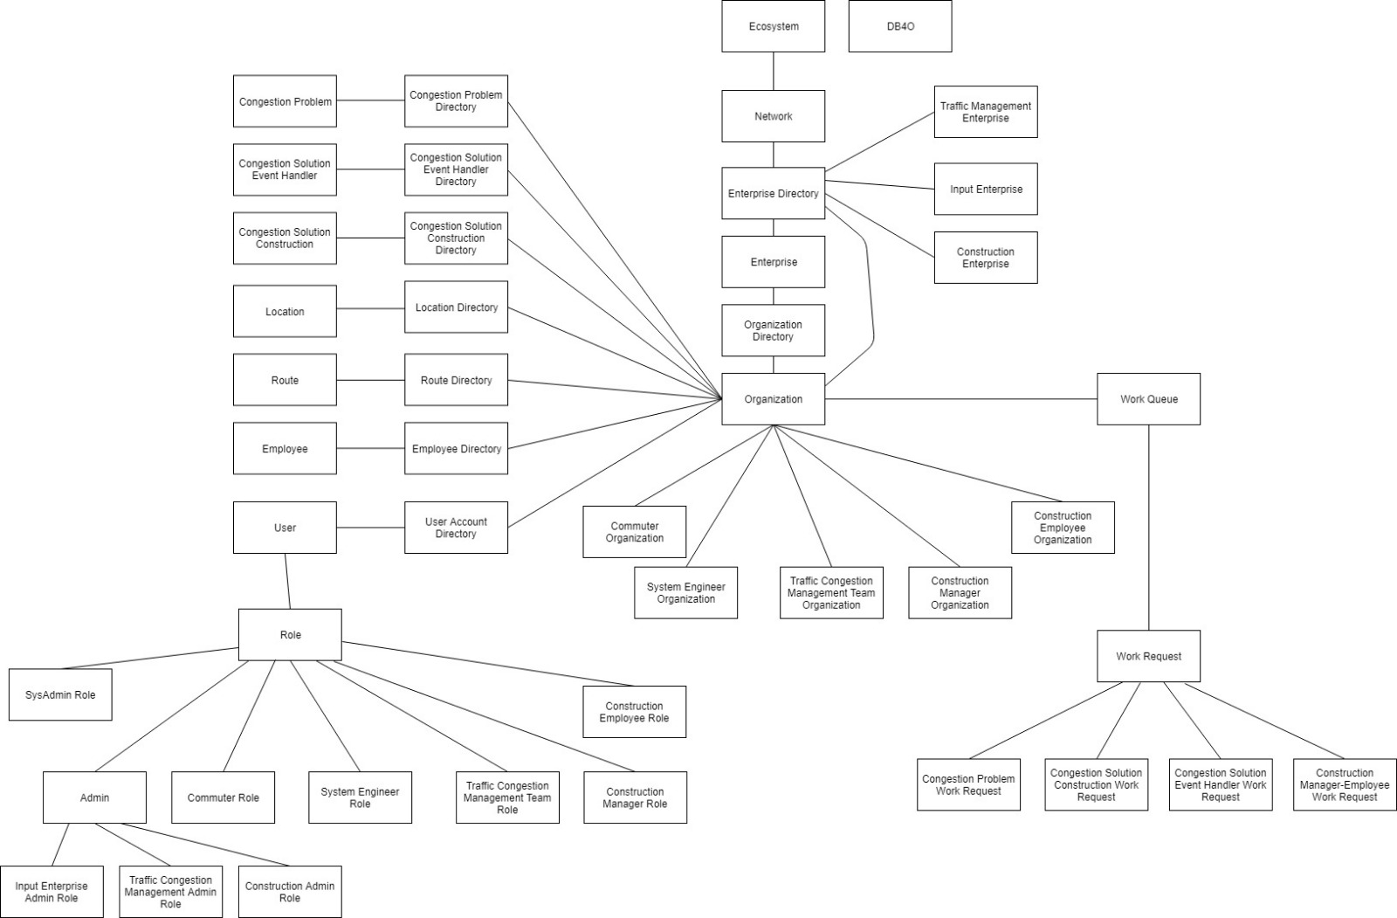
Object Model

Slide 7
Functionality
System Admin Role:
Responsibilities: Manages the entire System. Will create various enterprises and their respective admins .
Enterprise Admin Role:
Responsibilities: Manages the creation of organization , Employees and Login of Employees.
Commuter Role:
Responsibilities: He is the one who informs if there is any Congestion and can see the congested and free routes to his destination.

Slide 8
Functionality
System Engineer Role
Responsibilities: He is the one who gets the output from various sensors installed on the roads and sends the report to Congestion Management and Construction Management.
Traffic Congestion Manager Role:
Responsibilities: Manages the Traffic Congestion Organization. Basically he is the one who handles various Traffic Events.
Construction Manager Role:
Responsibilities: Manages the Construction Manager Organization. He can see all the construction related request and assign an employee for each request.
Construction Employee Role:
Responsibilities: Manages all the task assigned to him and proposes the Construction solution

Slide 9
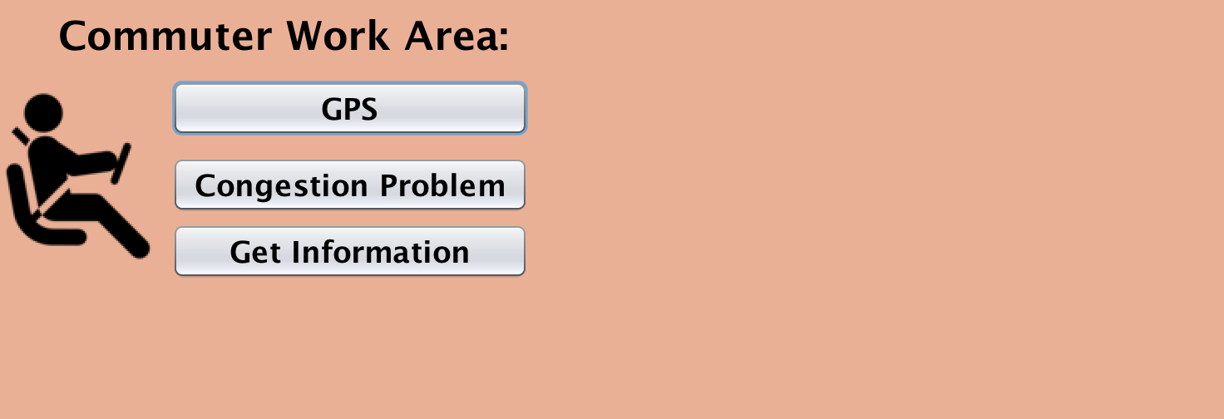
Screenshots-Commuter

Slide 10
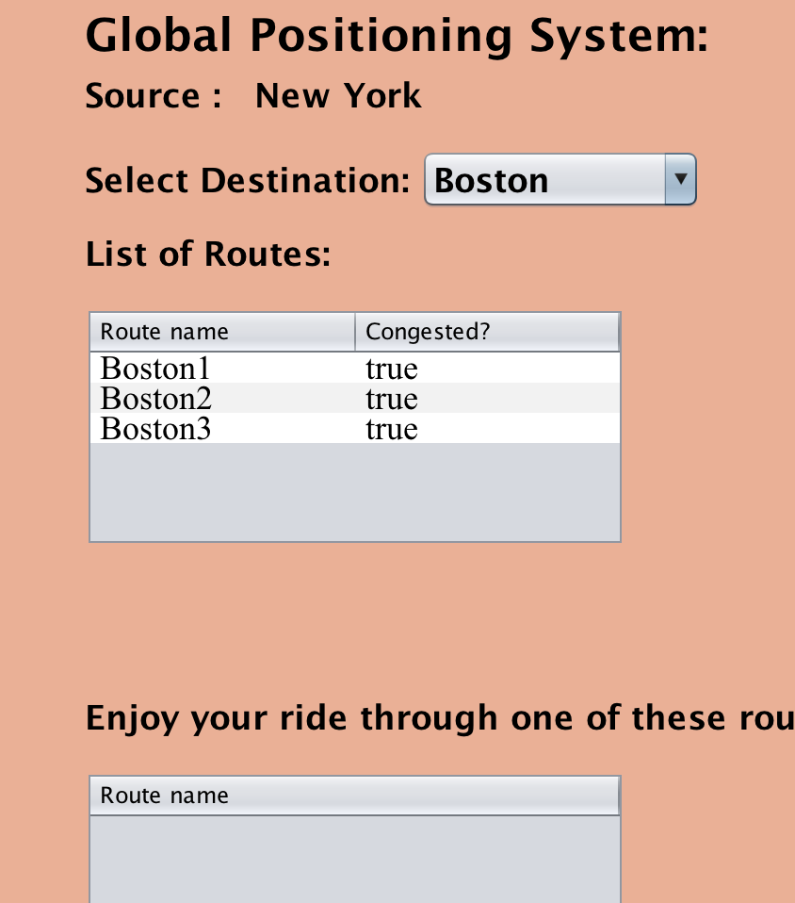
Screenshots-Commuter(GPS)

Slide 11
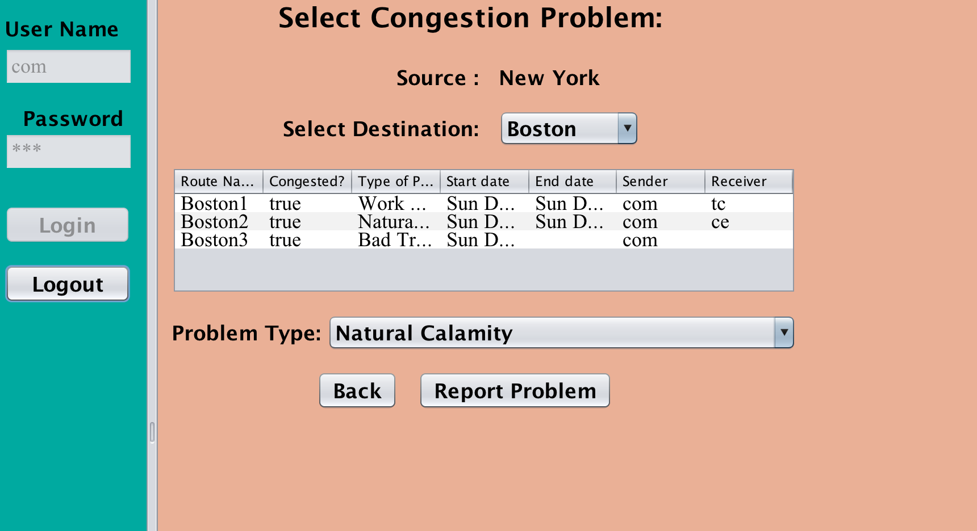
Screenshots-Commuter(Report Congestion)

Slide 12
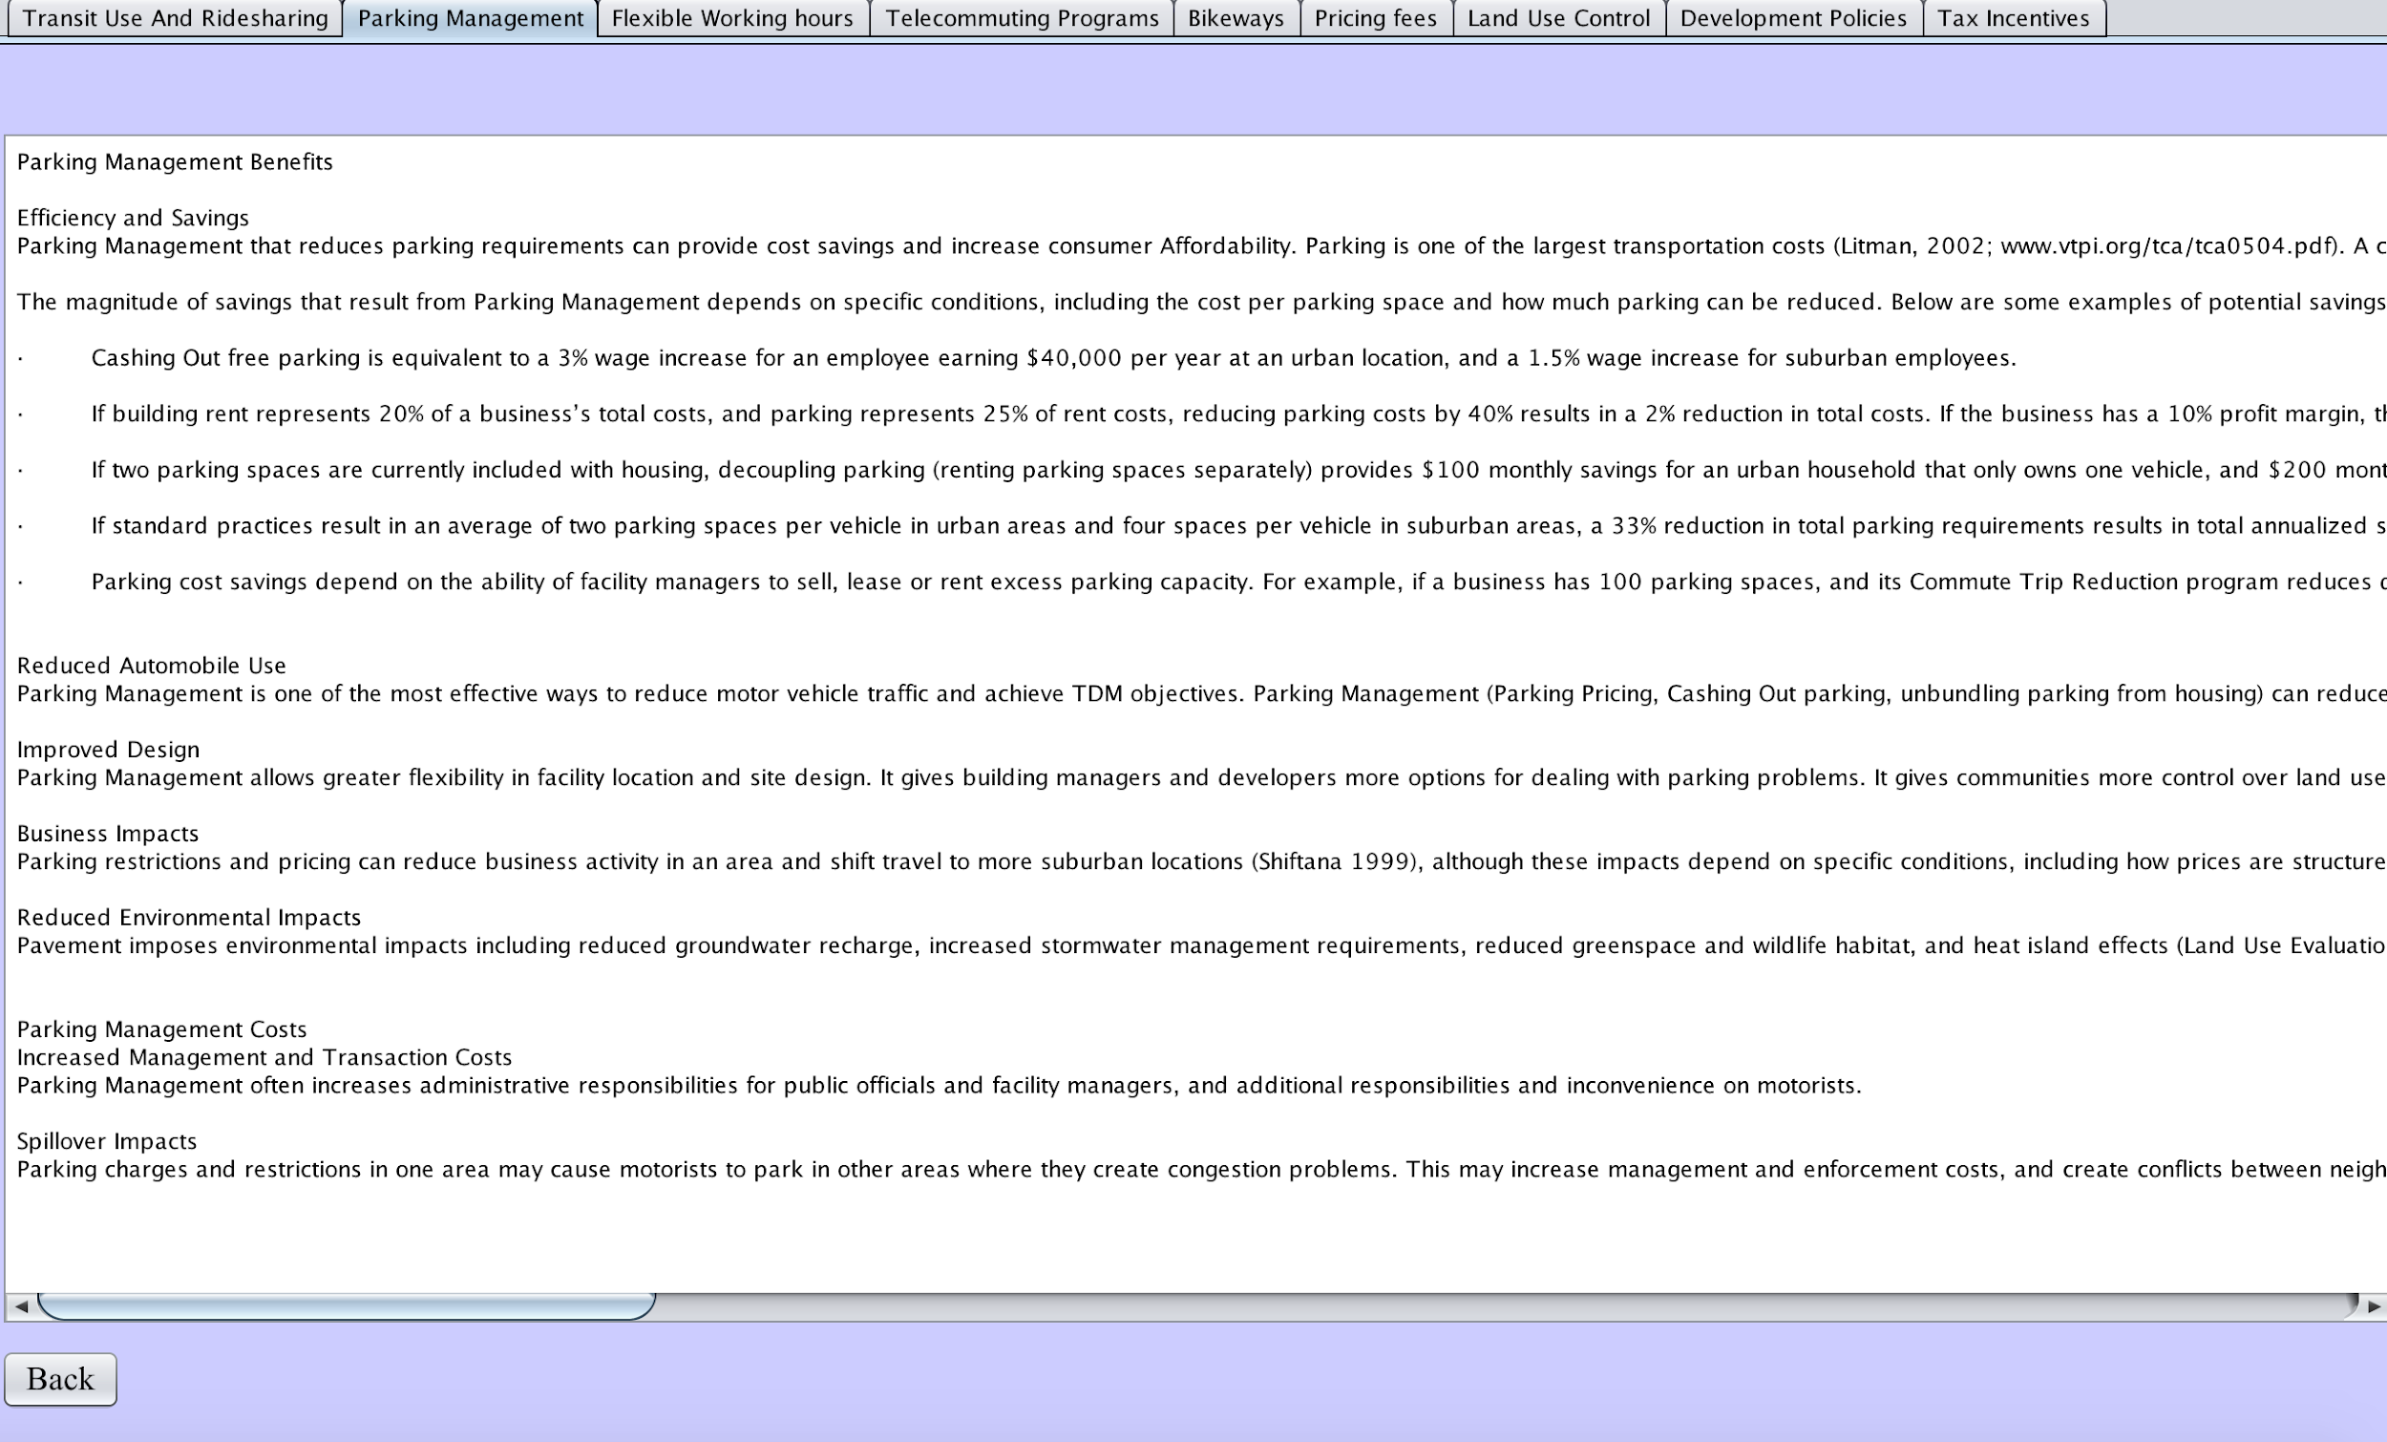
Screenshots-Commuter(Get Informed Module)

Slide 13
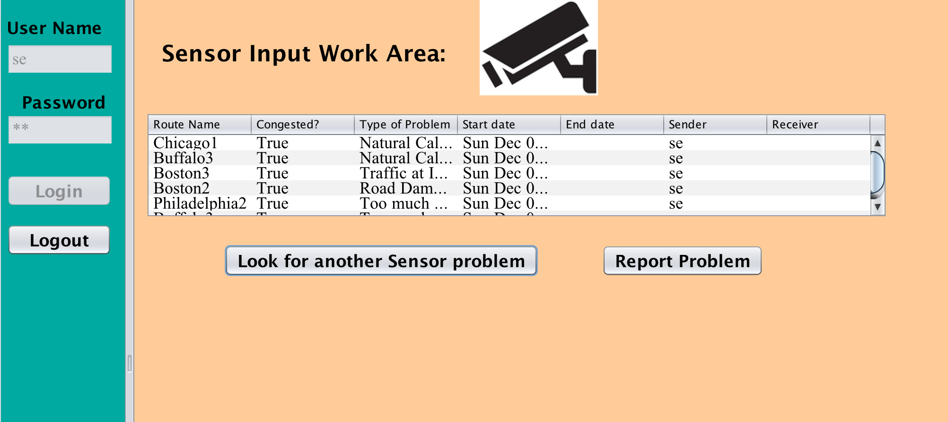
Screenshot-Sensor Input(Report Problem)

Slide 14
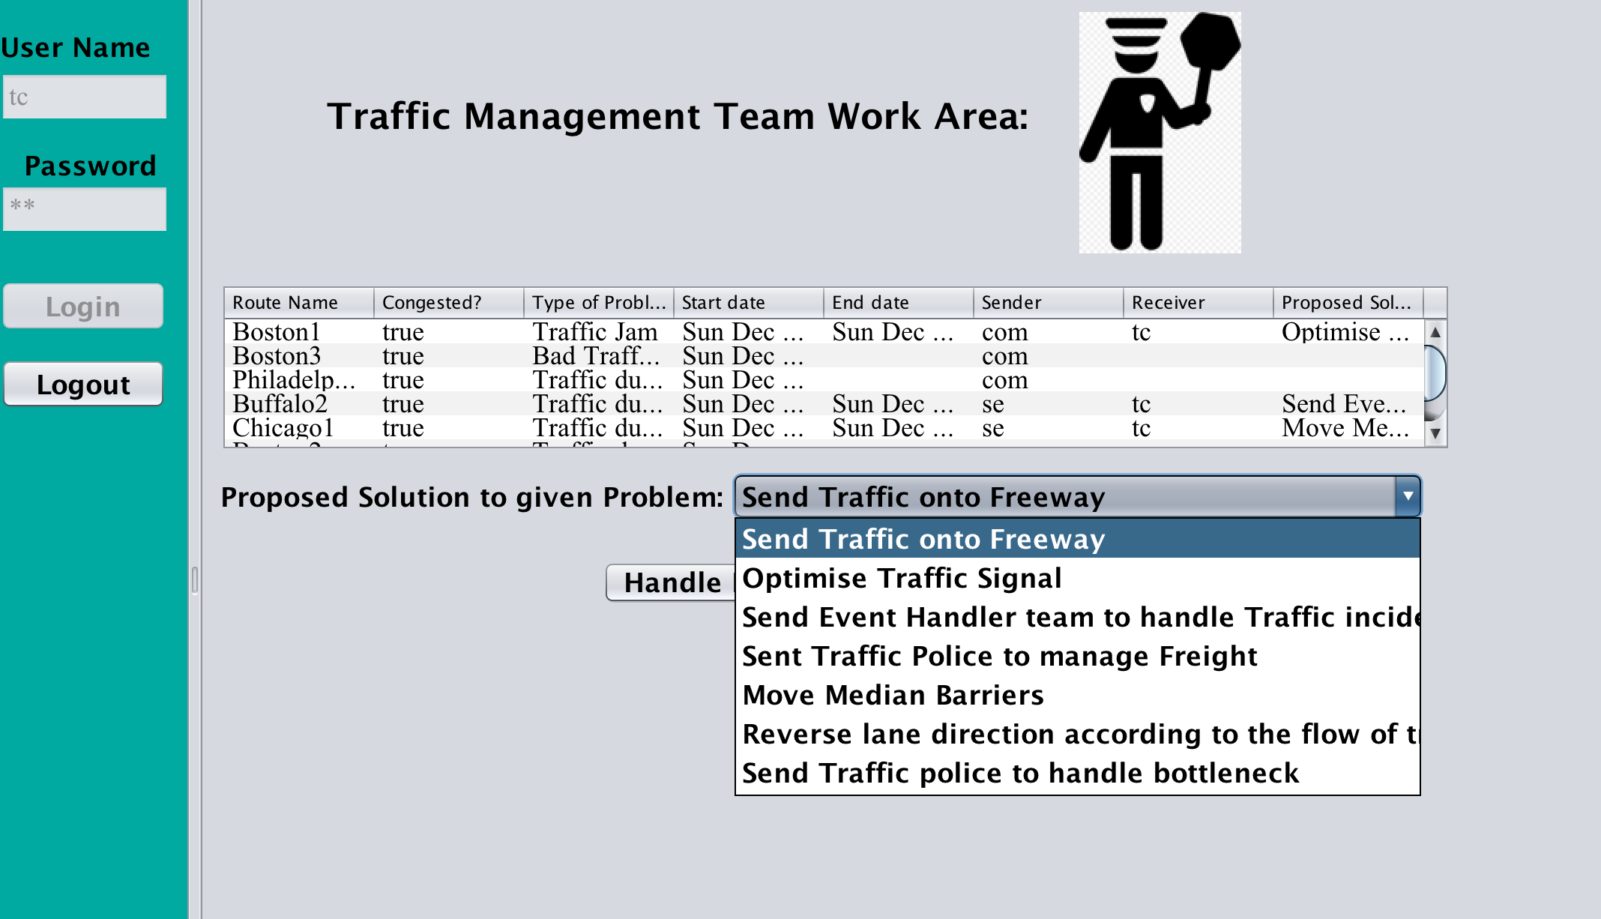
Screenshots-Traffic Congestion Management(Propose Solution)

Slide 15
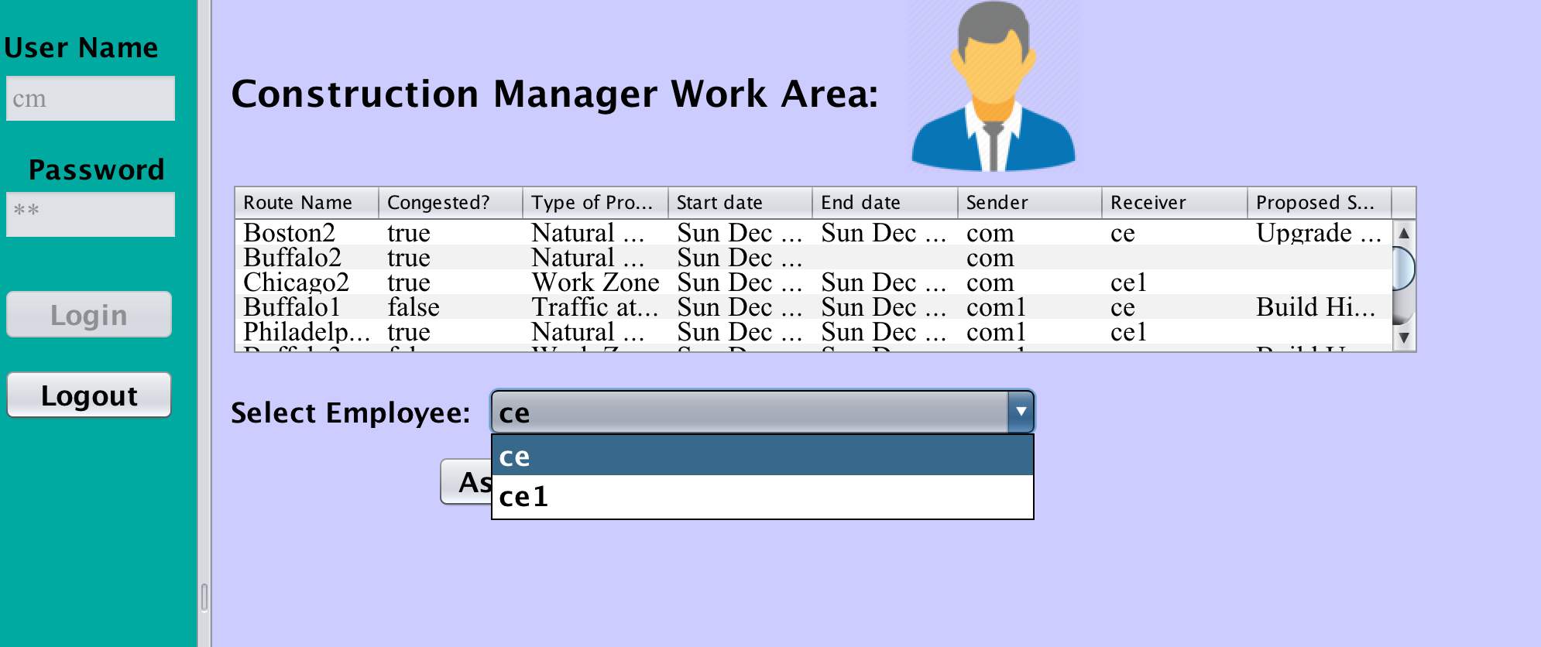
Screenshots-Construction Department Manager(Assign Employee)

Slide 16
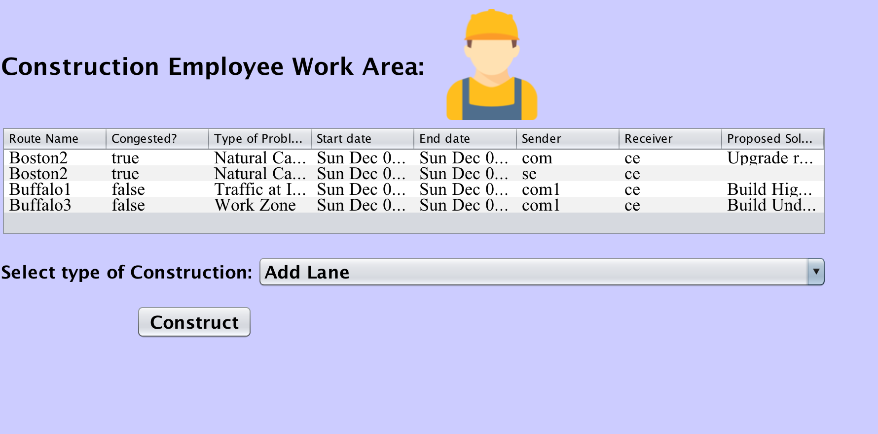
Screenshots-Construction Department Employee(Propose Solution)

Slide 17
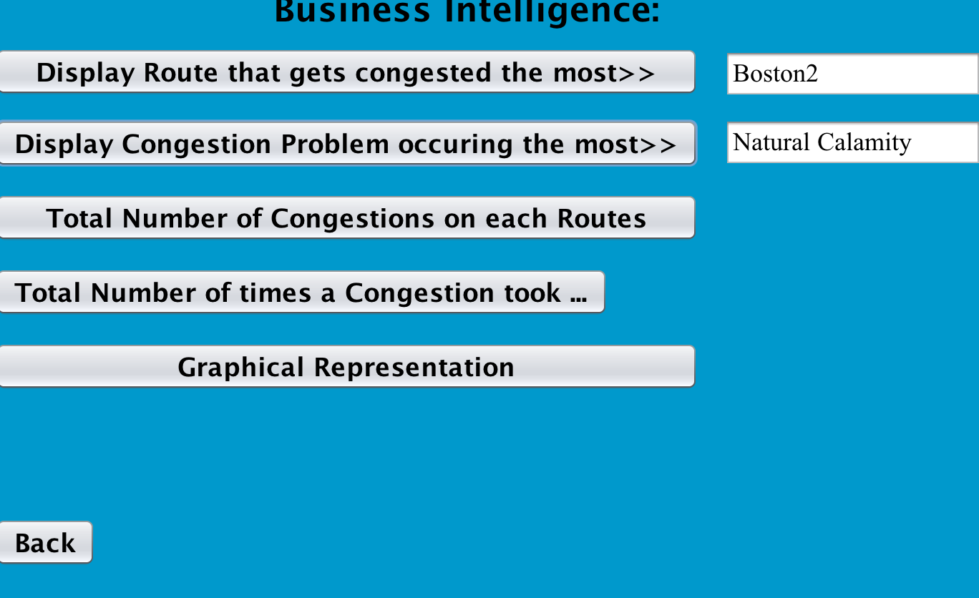
Business Intelligence

Slide 18
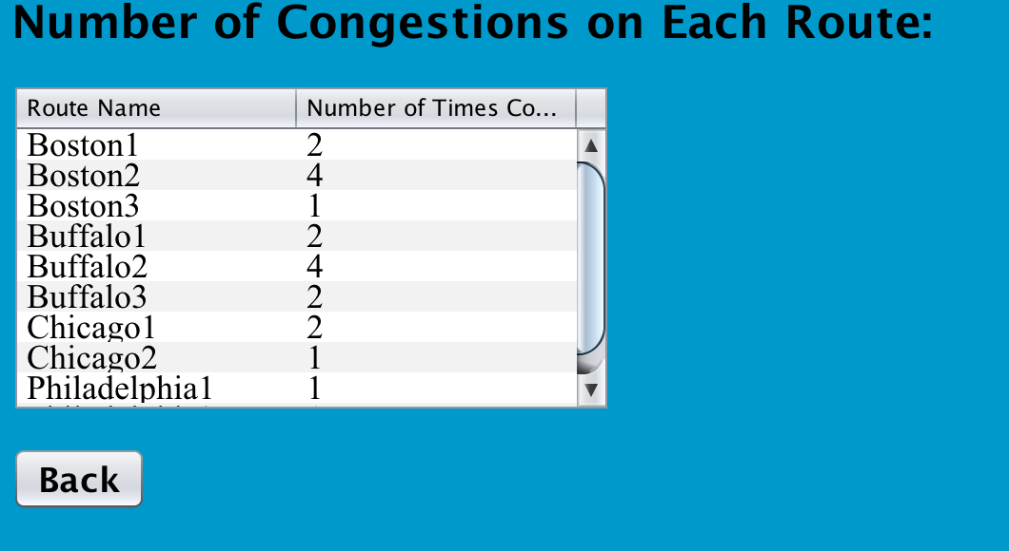
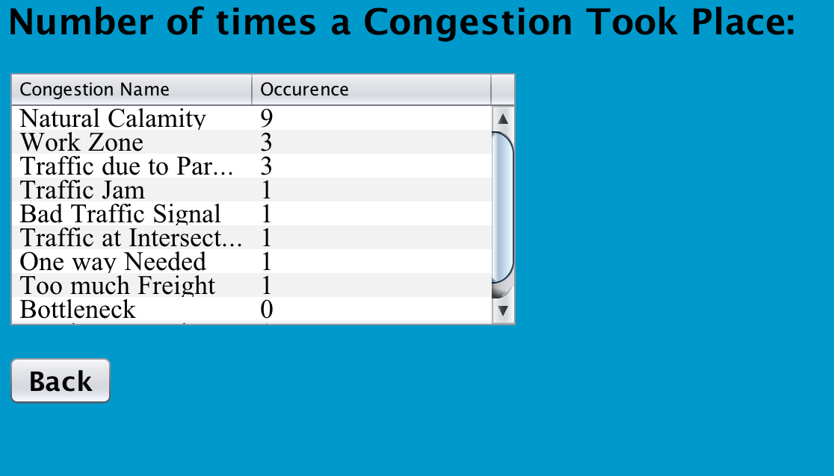
Business Intelligence

Slide 19
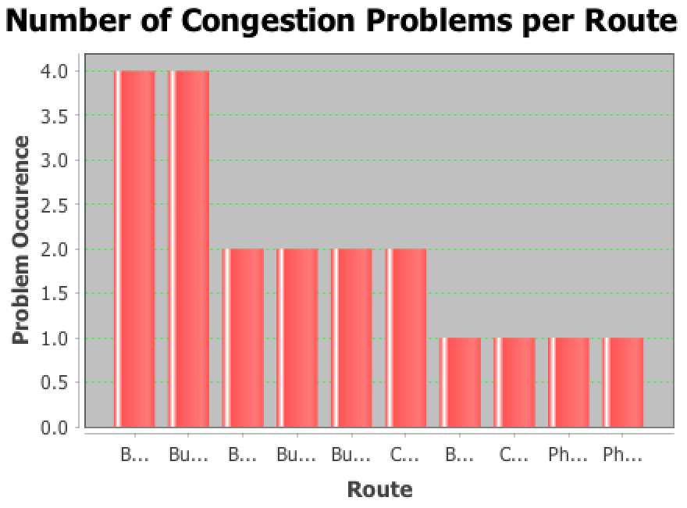
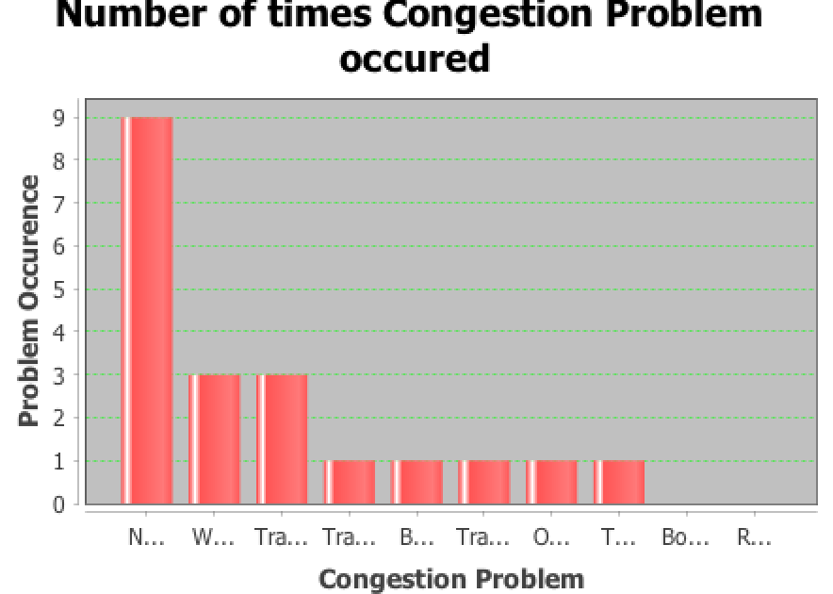
Business Intelligence

Slide 20
Thank You

